Slide 1
Employee’s hiring distribution and rating insights

Slide 2
INTRODUCTION….
INTRODUCTION.
INTRODUCTION..
INTRODUCTION...

Slide 3


Introduction
Name : Izzan Muhammad Fa’iz
Bachelor of Computer Engineering
In Telkom University
Huge interest in :
Technology
Data in general
Internet of Things (IoT)
izzanmfaiz@gmail.com
linkedin.com/in/izzan-m-fa-iz/

Slide 4
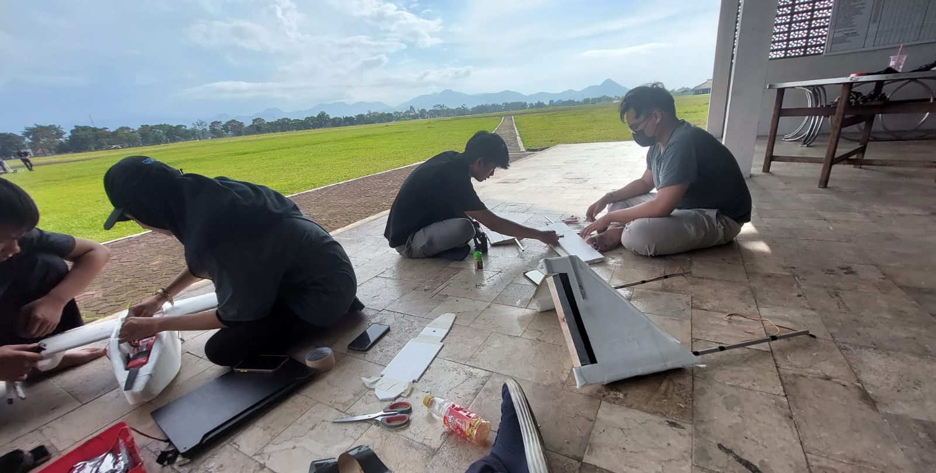
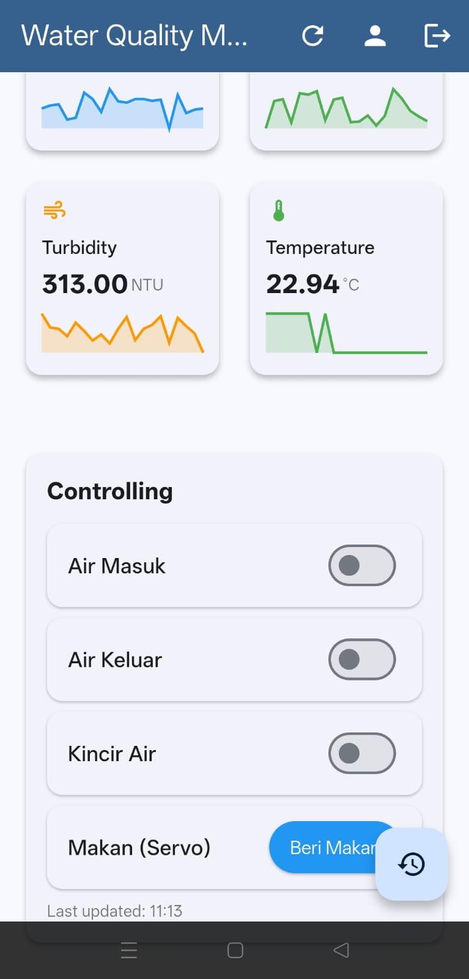
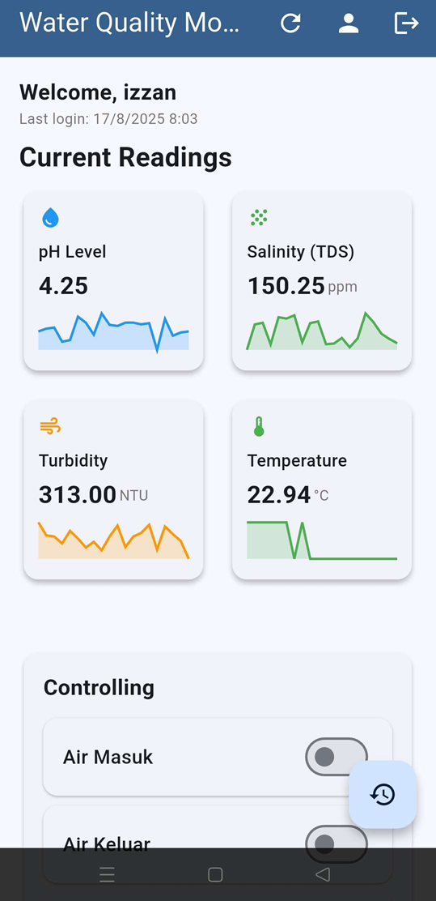
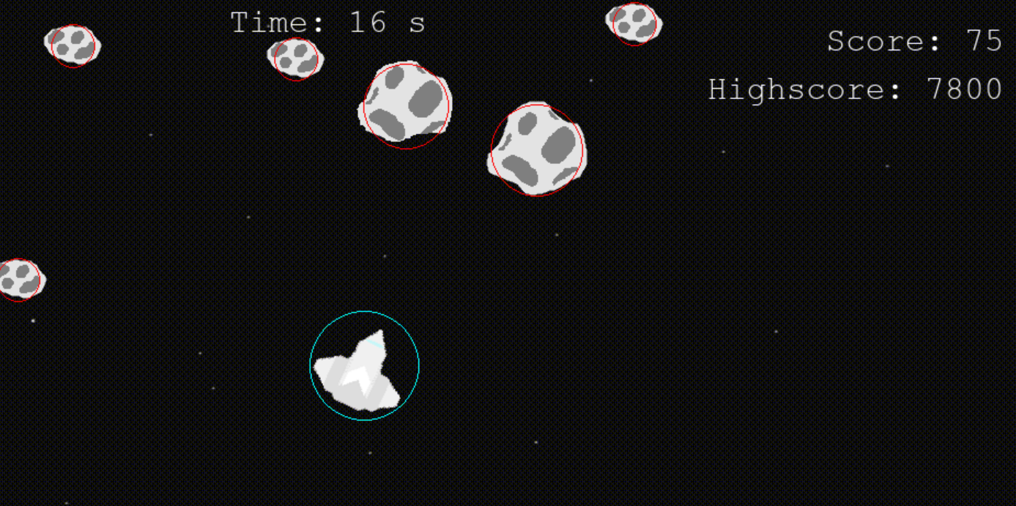
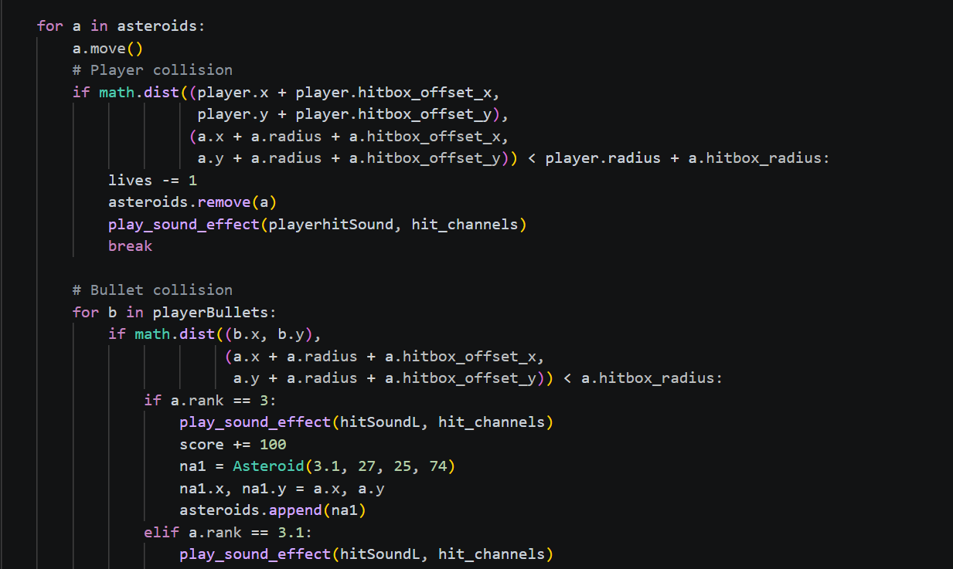
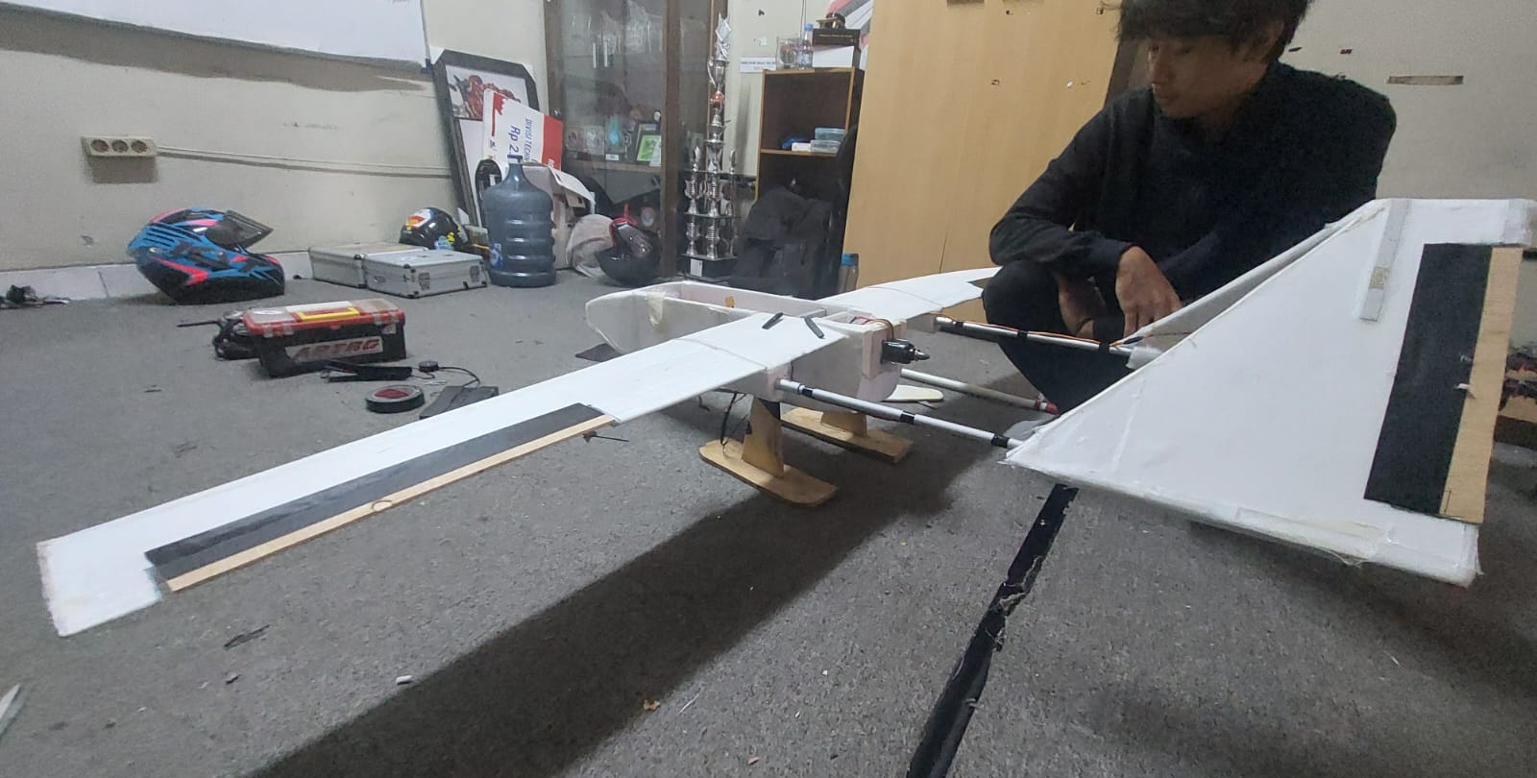
OVERVIEW PROJECT
APTRG (Aeromodelling and Payload Telemetry Research Group) - Designing Drones for both virtually and physically
ProcodeCG - Creating a python codes for childrens who wants to learn coding in early age.
Water Controls for Shrimps Aquaculture - Creating a system to control water quality parameter for shrimps.

Slide 5
MAIN PROJECT

Slide 6
This data analysis is used to predict when a company should conduct hiring, training, or firing based on employee ratings or age.
Main Project “Employee’s hiring distribution and rating insights.”

Slide 7
When to hire?
WHEN NEED TO TRAIN?
WHEN NEED TO FIRING?

Slide 8
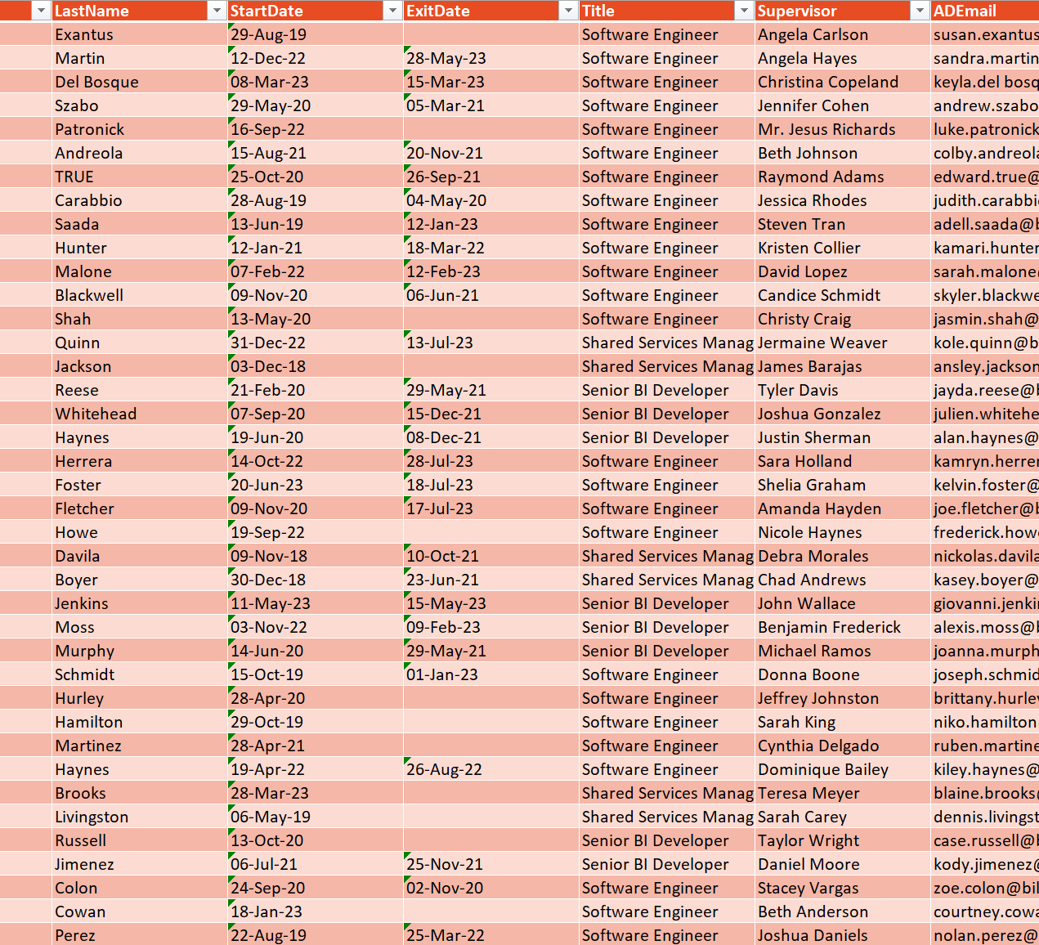
Data description
Dataset: employee_data.csv (Kaggle)
Total Employees : 3000 (rows)
Total Section : 26 Sections (column)
Section details : EmpID, FirstName, LastName, DoB, Start/ExitDate, Etc.
Data Problems :
Missing files in ExitDate section
Unecessary sections
Confusing sections

Slide 9
Data preparation

Slide 10
Data Cleaning
Data cleaning is the process of preparing data to ensure it is accurate, consistent, and free from errors.
For this case:
ExitDate(Missing Values) – Filled with “-”
Remove Unnecessary Section – Removing TerminationDescription, EmployeeClassificationType, Supervisor, etc.
Change cell format to date – DoB section
Choosing the important sections only for the analysis

Slide 11
Dashboard visualization

Slide 12
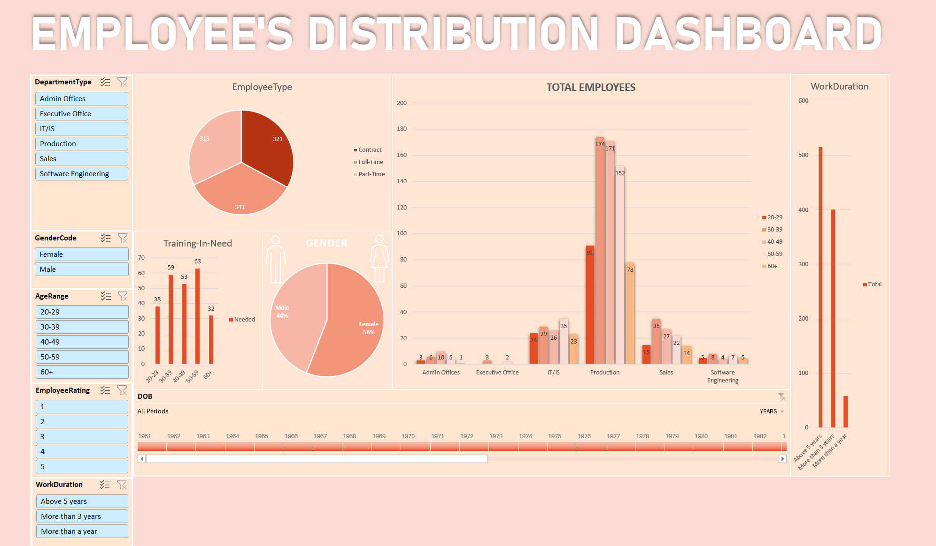

Slide 13
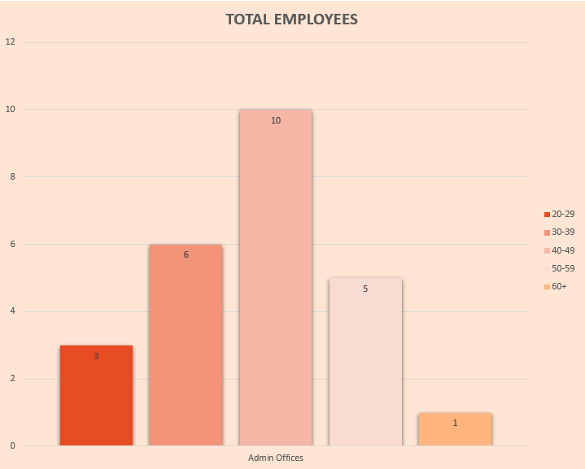
Insight #1, when to hire?
When there’s an aging force (Almost retired)
Under-Capacity
For Example :
Admin offices department total employees 25 employees in total of 967 employees(~2.5%) (under the normal benchmark of 3-8%)

Slide 14
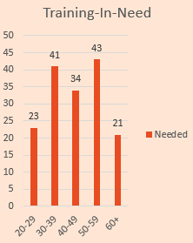
Insight #2, when to train?
When there are many low employee ratings
Gap-Perform between other department
For Example :
Production department has a total of 361 employees that are need in training (68%, highest than the other department)

Slide 15
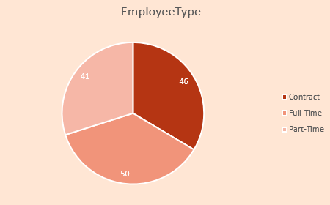
Insight #3, when need to firing?
When there’ s an overstaffing
Low ratings (individual firing)
For Example :
IT/IS has 137 employees in total of 967 for all department (14%, higher than the normal benchmark of 2-8%)

Slide 16
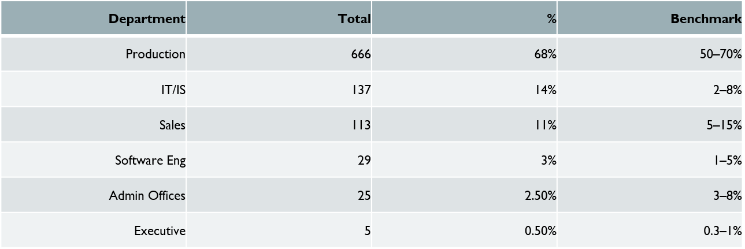
BENCHMARK

Slide 17
Conclusion
A data-driven approach in employee management can help companies increase productivity, optimize resources, and support more effective and sustainable decision-making.

Slide 18
Thank you!

